Slide 1
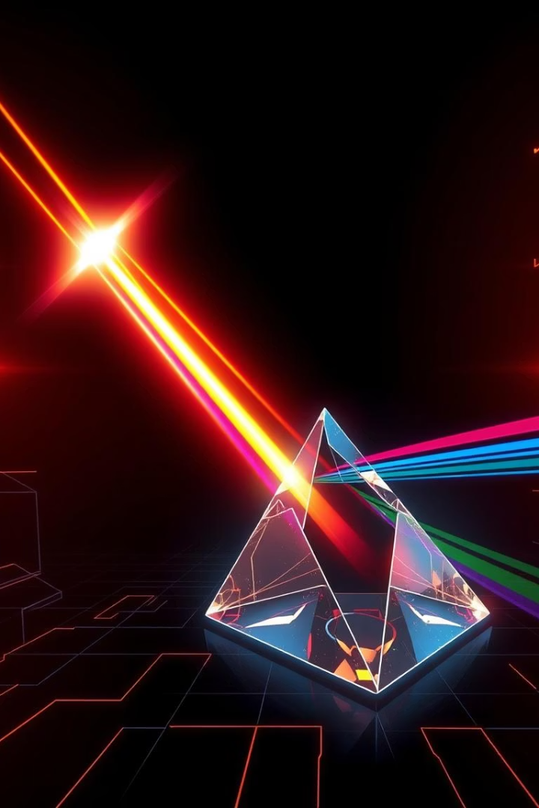
The Magic of Light: Refraction and Dispersion
Let' s embark on an exciting journey to explore how light behaves when it passes through a prism, uncovering the secrets behind rainbows and vibrant colours.

Slide 2
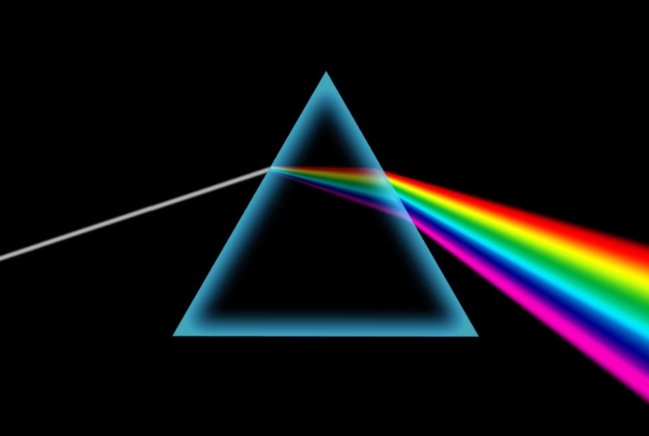
Understanding Refraction in a Prism
When light enters a prism, it bends. This bending is called refraction. It happens because light changes speed as it moves from one material to another.
Unlike a flat glass slab, a prism's unique shape makes the light bend in a special way.

Slide 3
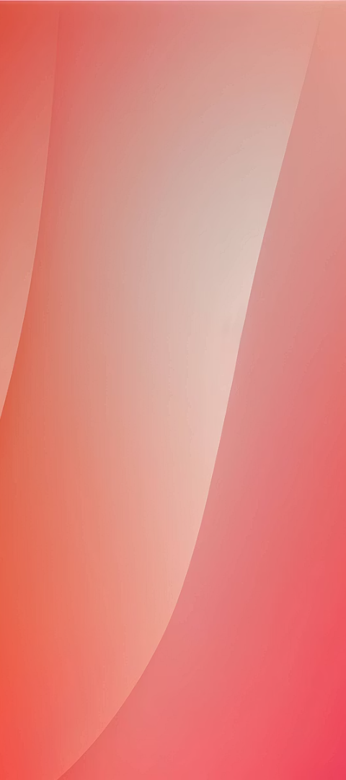
The Angle of the Prism
Prism Shape
Inclined Surfaces
A triangular glass prism has two flat triangular bases. It also has three rectangular sides.
These rectangular sides are angled towards each other. They are not parallel.
Angle of Prism
The angle between two of these slanted sides is called the "angle of the prism."
This angle is key to how the light bends inside the prism.

Slide 4
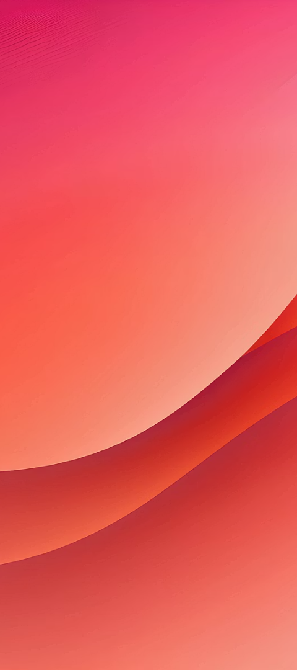




Tracing the Path of Light
Set up
Place a prism on white paper. Draw its outline.
Incident Ray
Place two pins to mark the incoming light ray.
Emergent Ray
Look through the prism. Place two more pins in line with the images.
Connect Dots
Remove pins and prism. Draw lines to show light's path.
This activity helps us see exactly how light bends.

Slide 5
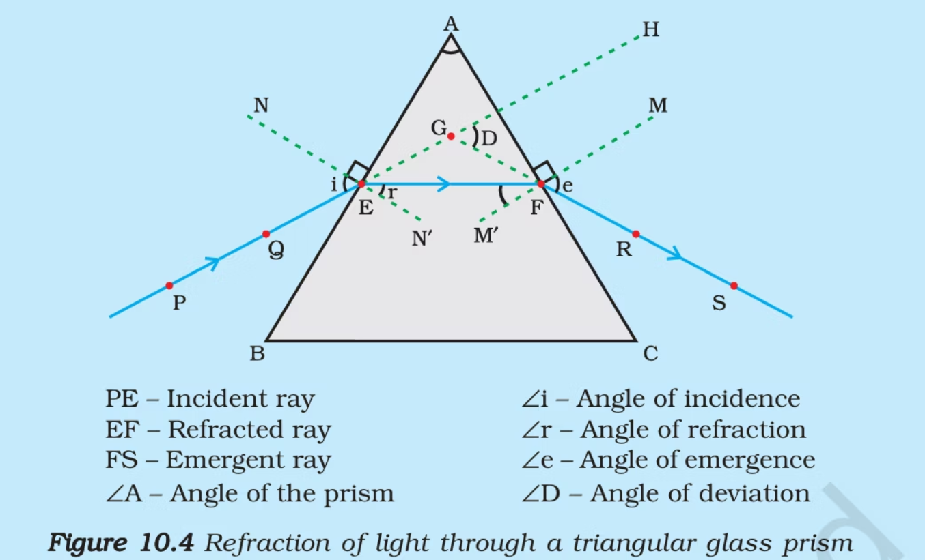

Slide 6
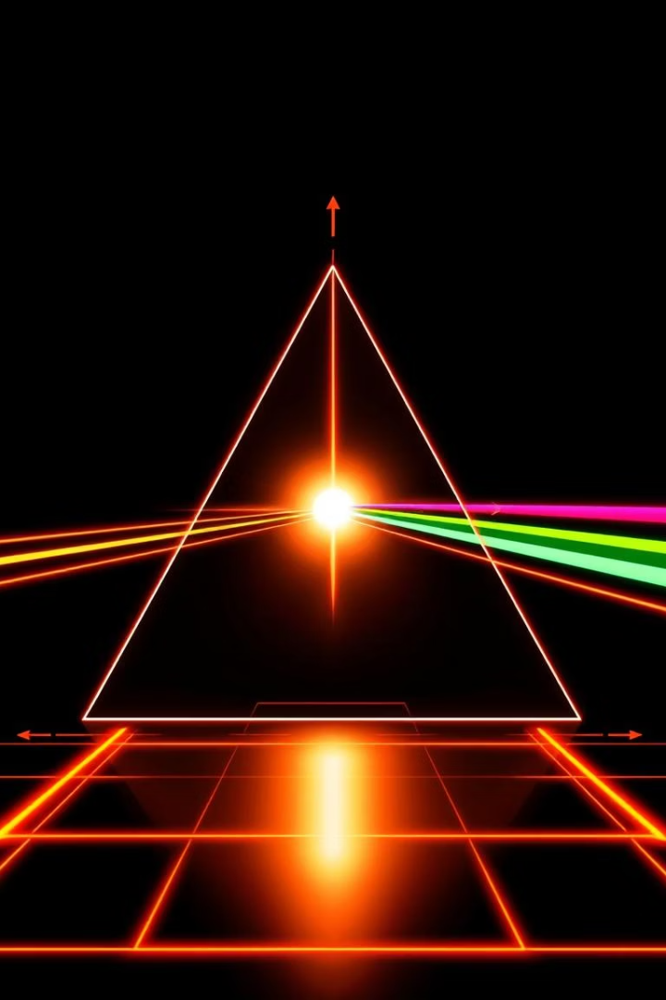
Angles of Refraction
Let's define the angles involved as light passes through the prism.
Angle of Incidence (∠i)
Angle of the incoming light ray.
Angle of Refraction (∠r)
Angle of the light ray inside the prism.
Angle of Emergence (∠e)
Angle of the light ray leaving the prism.
Angle of Deviation (∠D)
Total bending of the light ray.

Slide 7
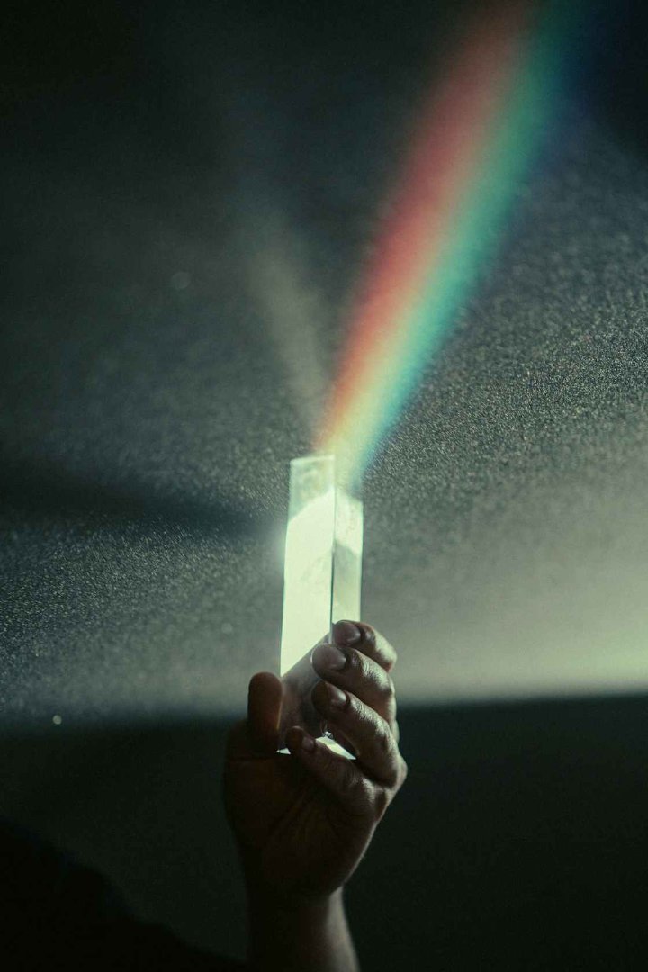



Deviation from the Path
Unlike a glass slab, a prism bends the emergent ray. It does not stay parallel to the incident ray.
Bending Rule
Light bends towards the normal when entering glass. It bends away when leaving glass.
Prism's Effect
The prism's shape makes the light bend at an angle. This is its "angle of deviation".
Measure It
You can measure this angle of deviation. It shows how much the light changed direction.

Slide 8






Dispersion of White Light
Have you ever wondered how a rainbow forms? It's all thanks to a prism!
Through Prism
Shine this white light through a glass prism.
White Light
Start with a narrow beam of sunlight. It looks white.
Band of Colours
A beautiful band of colours appears on a screen.

Slide 9
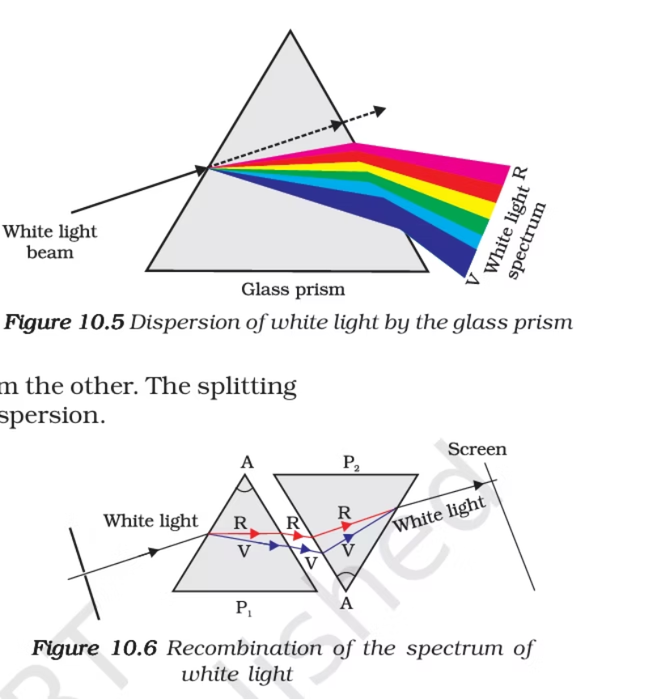

Slide 10
The Spectrum of Colours: VIBGYOR
1
Violet
2
Indigo
3
Blue
Bends the most.
Next in sequence.
Common cool colour.
4
Green
5
Yellow
6
Orange
Middle of the spectrum.
Bright and warm.
Next to red.
7
Red
Bends the least.

Slide 11




Why Does Light Disperse?
Dispersion happens because each colour of light bends differently through the prism.
Red Light
Bends the least. It has the longest wavelength.
Violet Light
Bends the most. It has the shortest wavelength.
This difference in bending angles separates white light into its component colours.

Slide 12
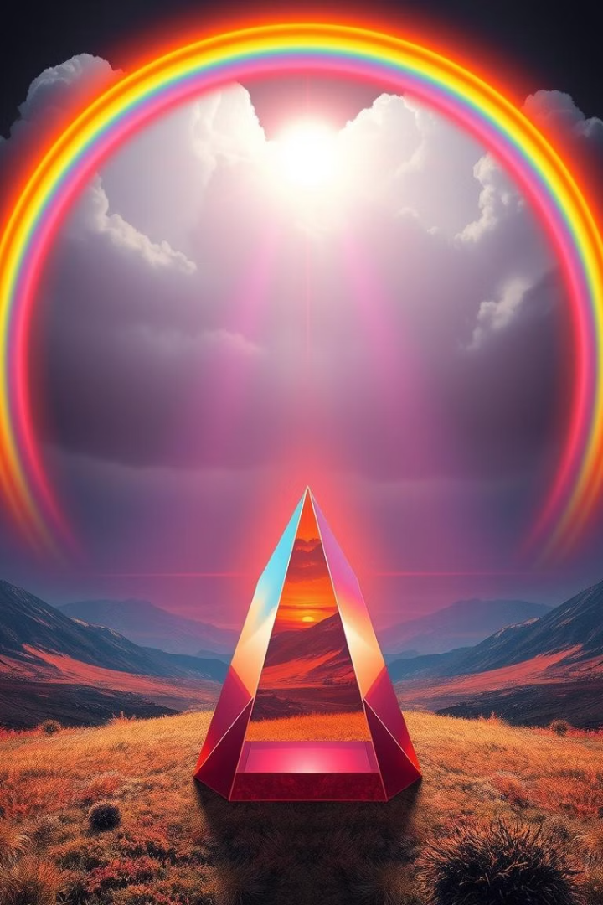



Key Takeaways from Prisms
Prisms teach us important lessons about light's behaviour.
Refraction
Dispersion
Spectrum
Light bends when it enters and leaves the prism.
White light splits into its seven colours.
The band of colours is called a spectrum (VIBGYOR).
Understanding prisms helps us grasp phenomena like rainbows.

Slide 13
THANK YOU
😉

